Slide 1
Massively Parallel Processing (MPP) Architecture in Synapse SQL Pools
John Deardurff
Cloud Solution Architect - Engineer

Slide 2

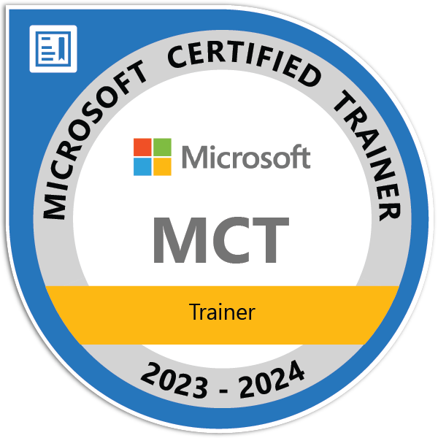
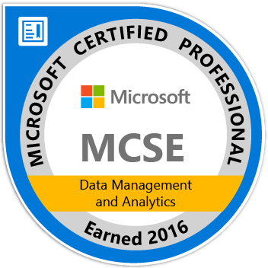
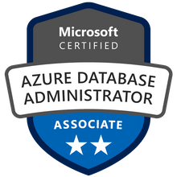
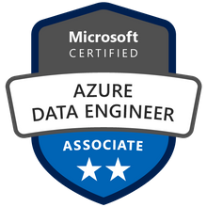
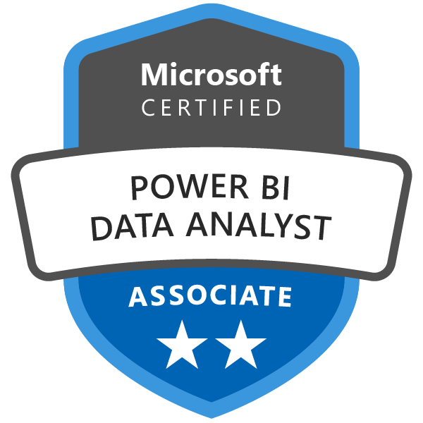

John Deardurff
Cloud Solution Architect - Engineer (Data & AI)
Microsoft Certified Trainer (Regional Lead)
MVP: Data Platform (2016 – 2018)
Email: John.Deardurff@Microsoft.com
Twitter: @SQLMCT
Website: www.SQLMCT.com
GitHub: github.com\SQLMCT

Slide 3
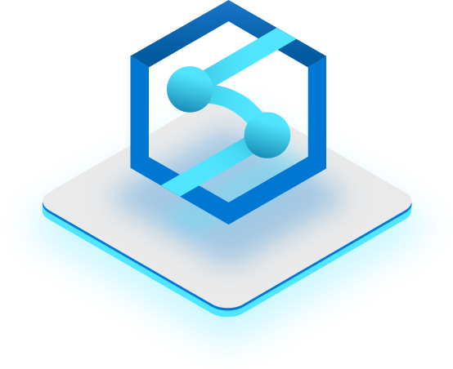
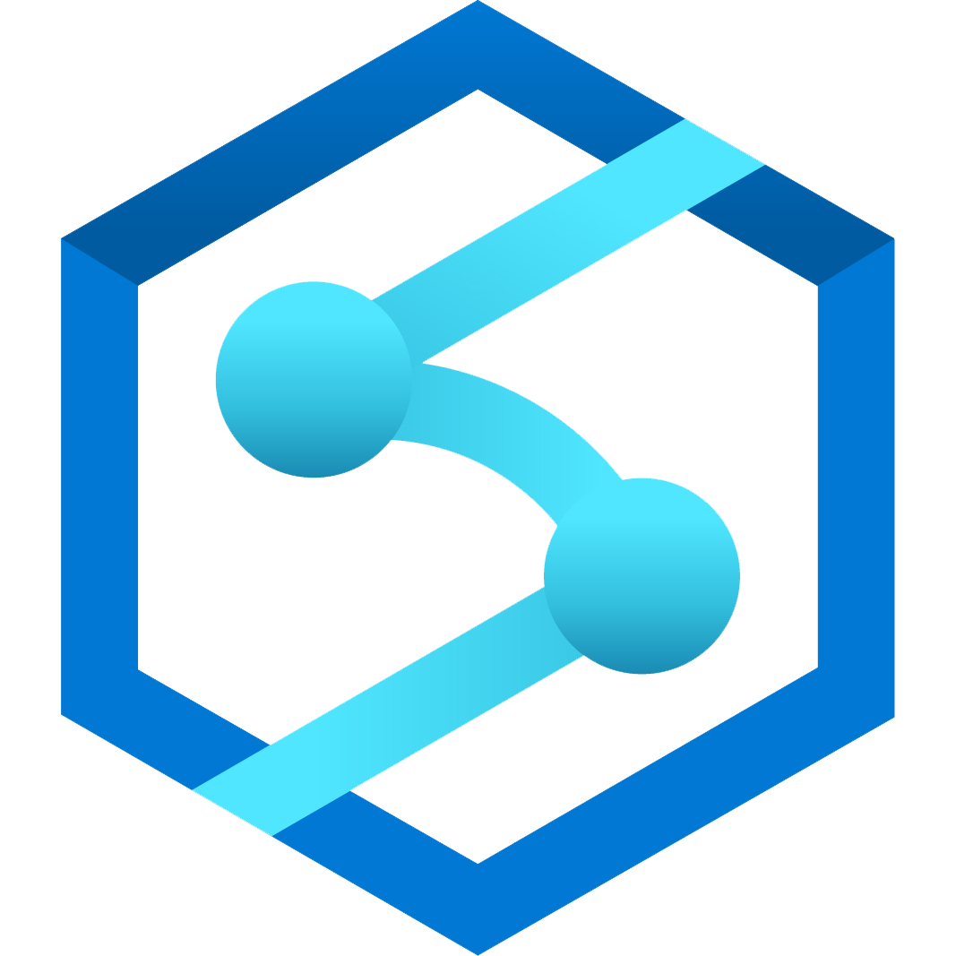
Key Concepts
MPP Architecture
Control Node
Compute Nodes
Table Distributions
Scaling Compute
Azure Synapse Intro
Notes:
Let’s talk about each of these concepts individually

Slide 4
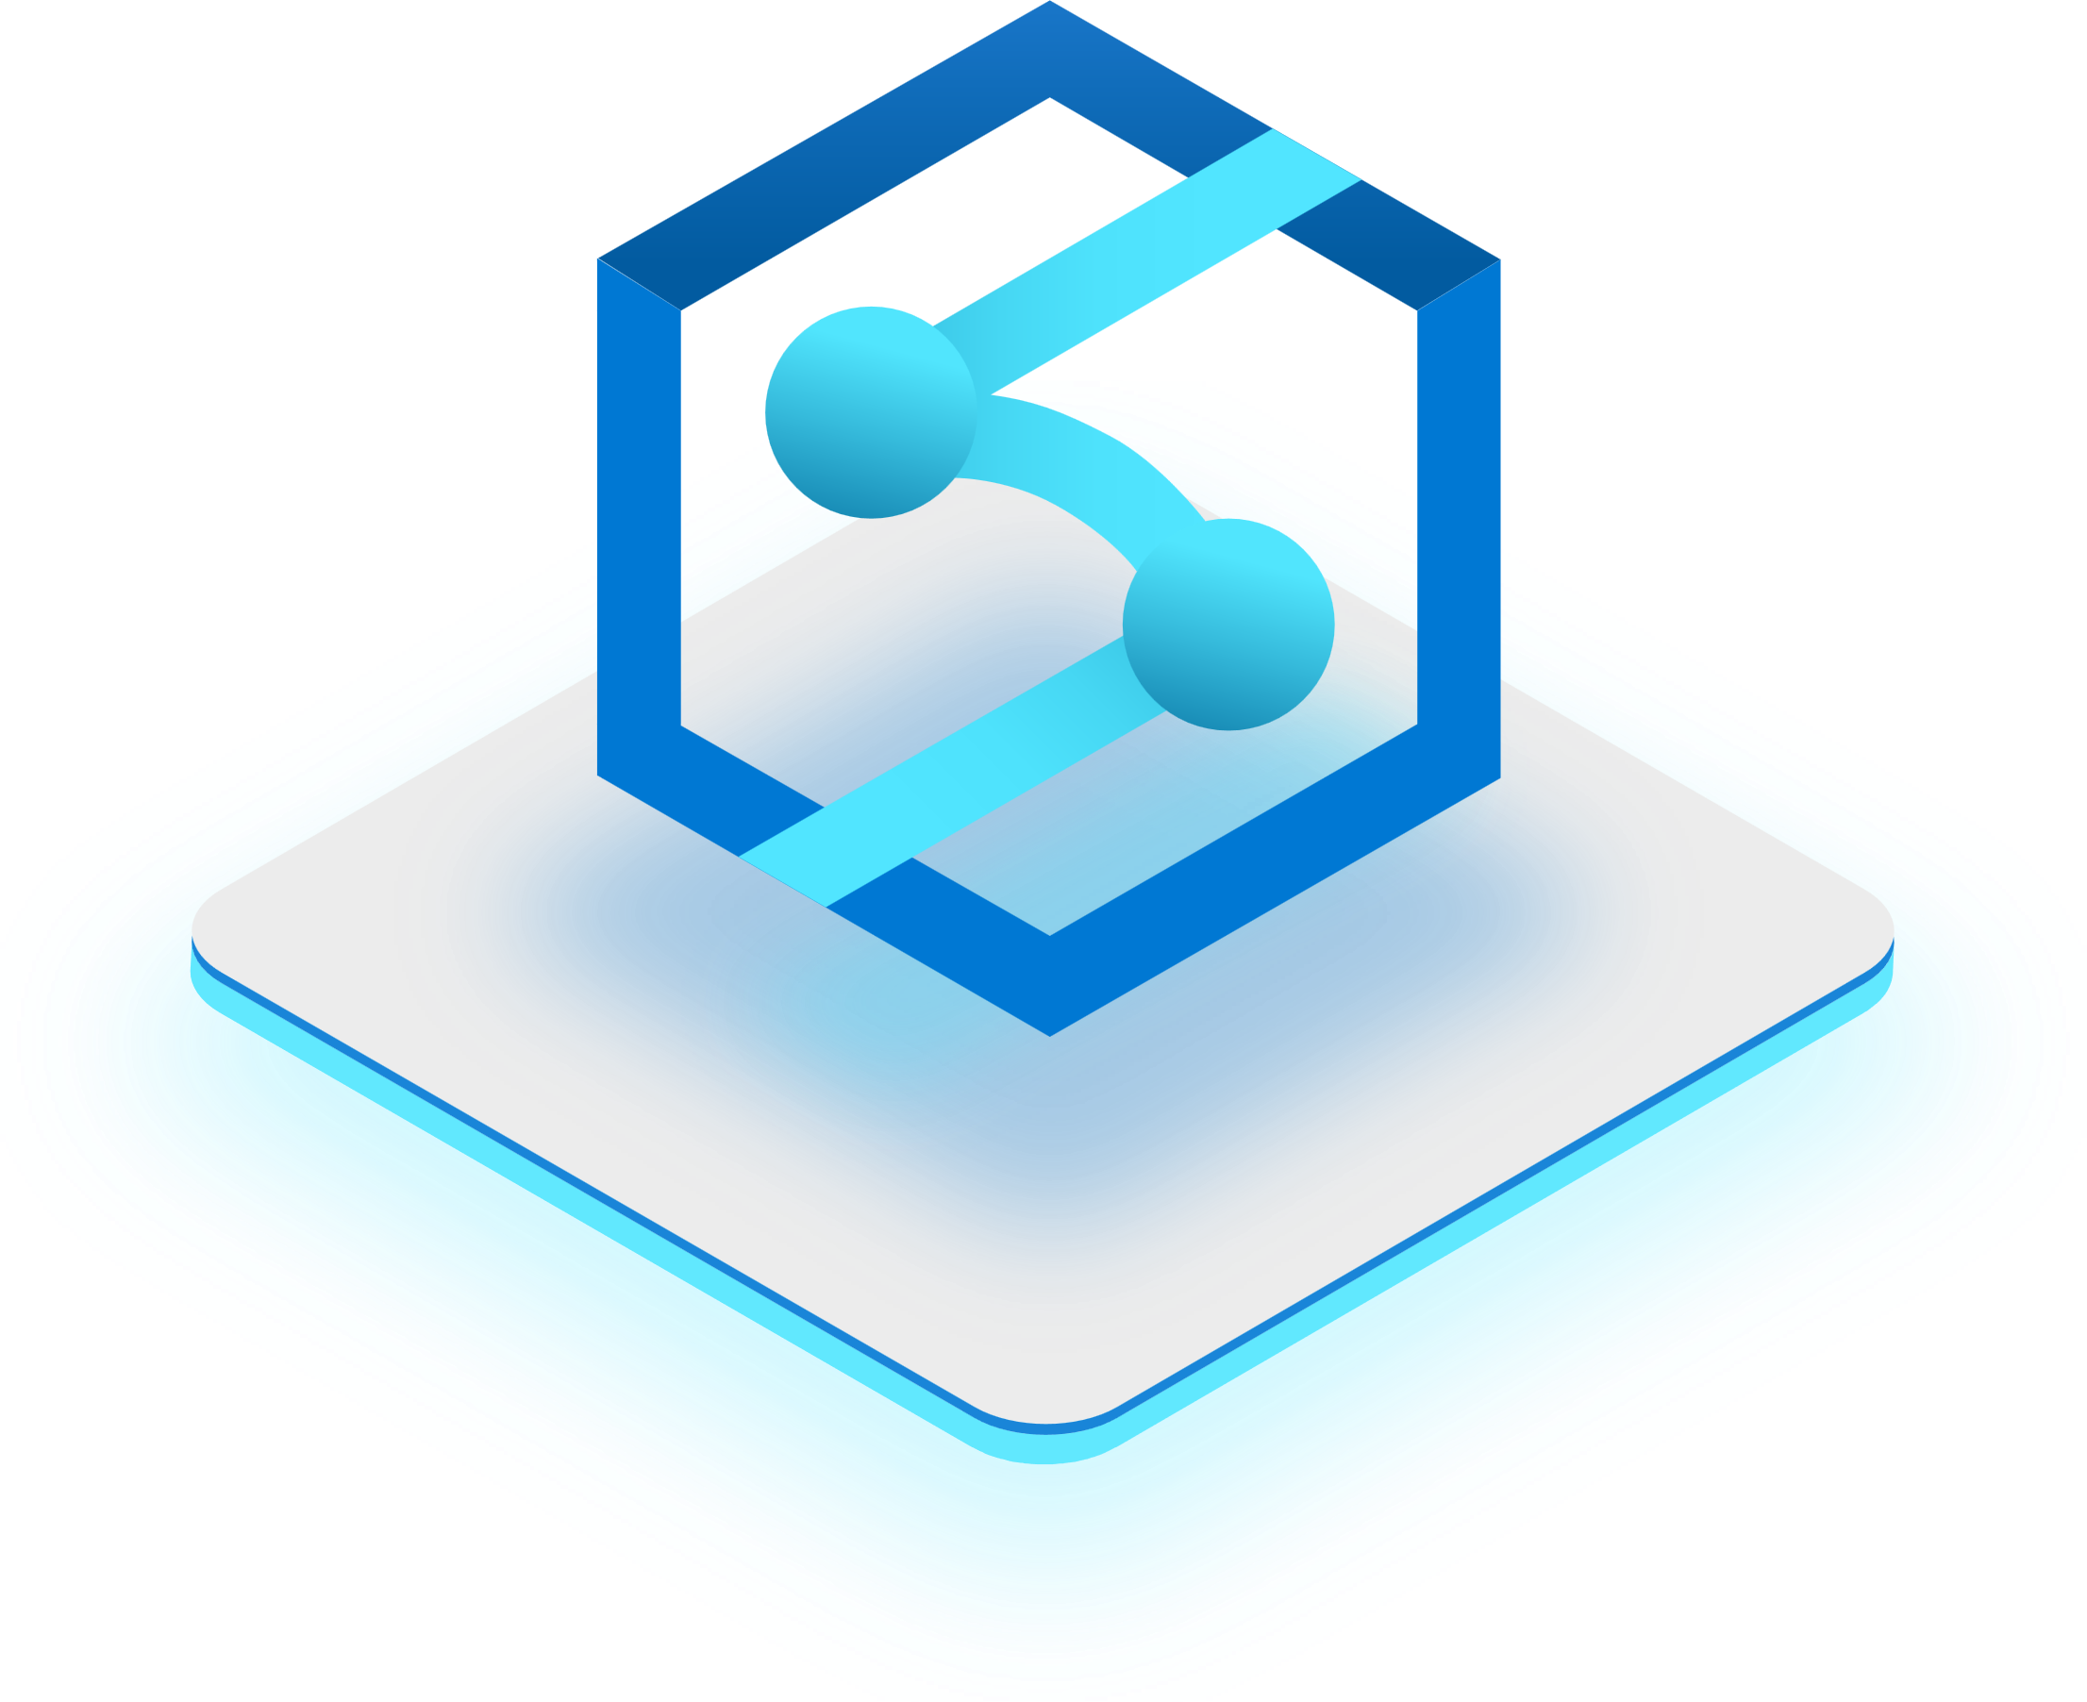
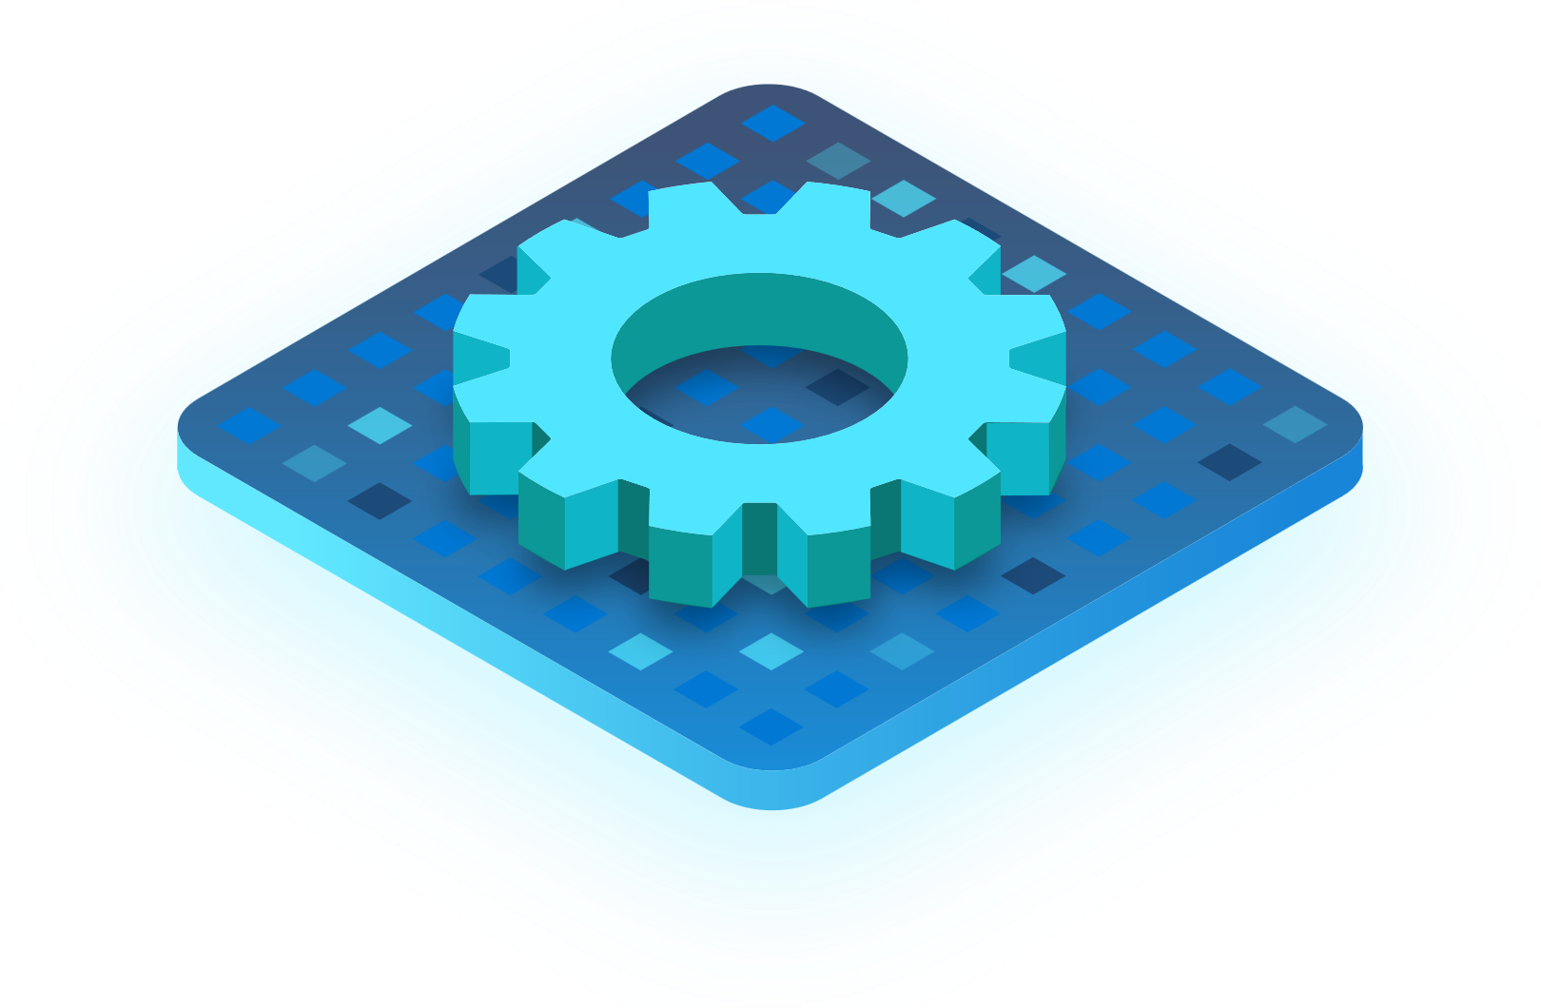
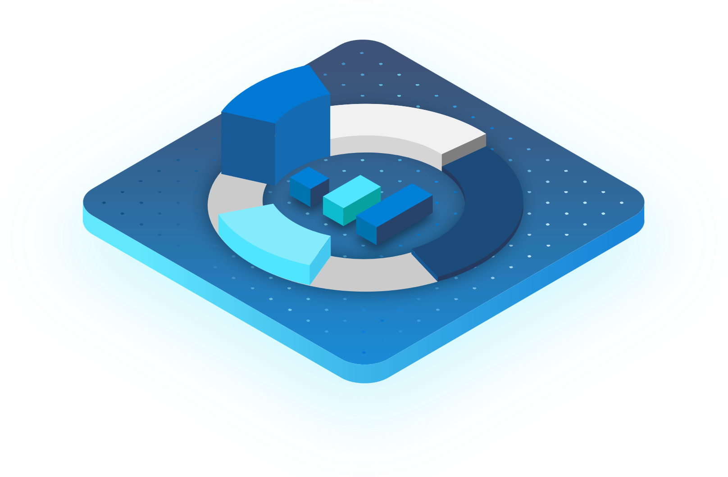
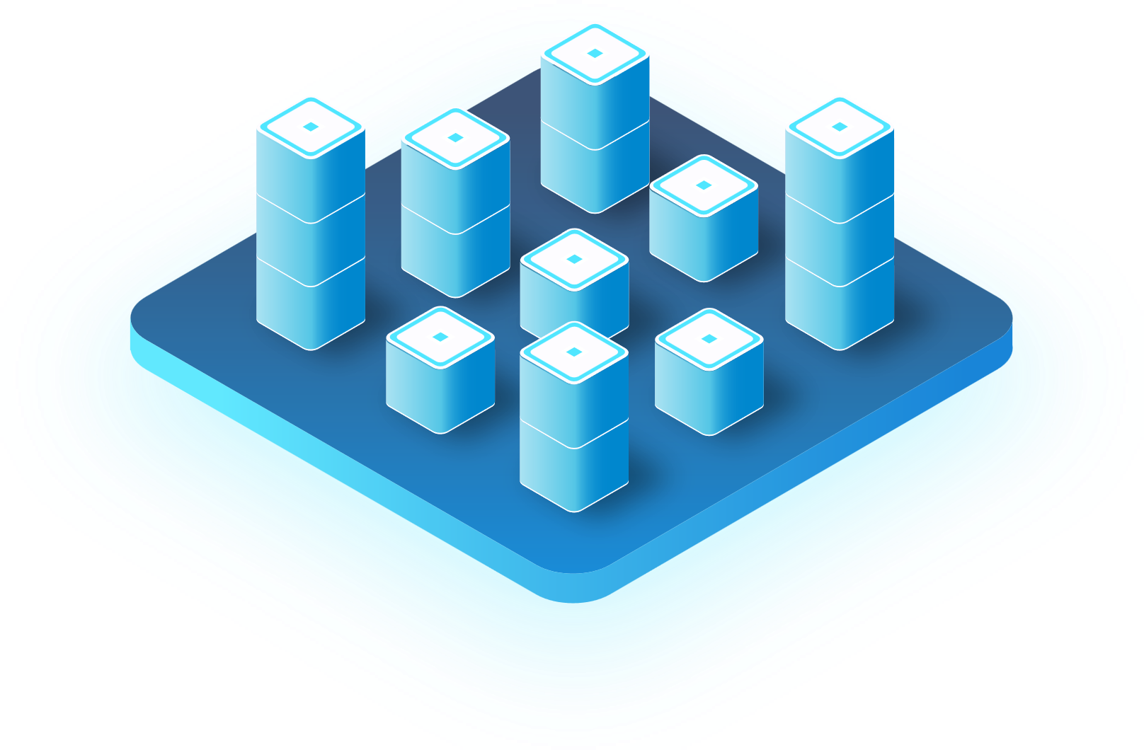
Azure Synapse Analytics
The first unified, cloud native platform for converged analytics
Azure Synapse is the only unified platform for analytics, blending big data, data warehousing, and data integration into a single cloud native service for end-to-end analytics at cloud scale.
Data integration
Big data analytics
Data warehousing
Notes:
With Synapse you get a complete/out-of-the-box solution
accelerates your time-to-insights and improves your business agility
Synapse = the only end-to-end platform that unifies data ingestion + big data analytics + data warehousing —at cloud scale.
simplifies the data chores: securing pipelines, assigning permissions to users for each service, building firewalls, etc.
→ It offers configuration options on a fully-managed infrastructure, so you can focus on what matters, not managing infra.
→ Instead of stitching a multitude of services together or creating a siloed point solution for just 1 of these 3 areas…
Synapse unifies your data, your data tasks, and your data teams with a limitless analytics service that does it all.
With Azure Synapse, all you do is secure your Synapse Studio and Microsoft Azure team takes care of the rest. Simplified analytics is what you have been asking for. And simplified analytics is what Azure Synapse delivers.

Slide 5
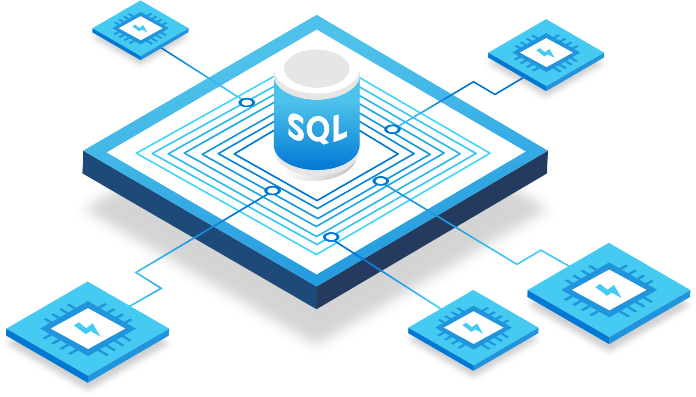
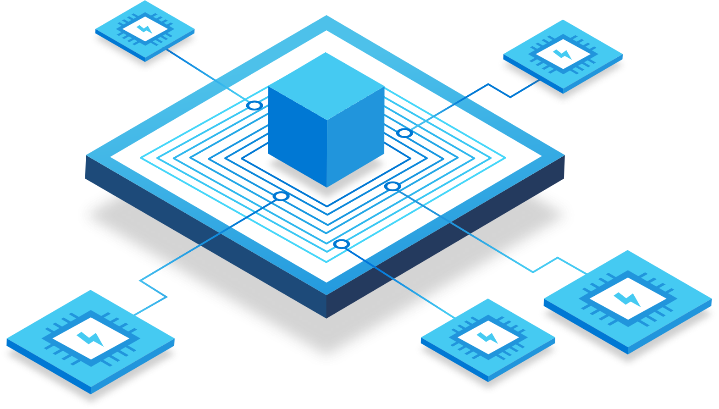
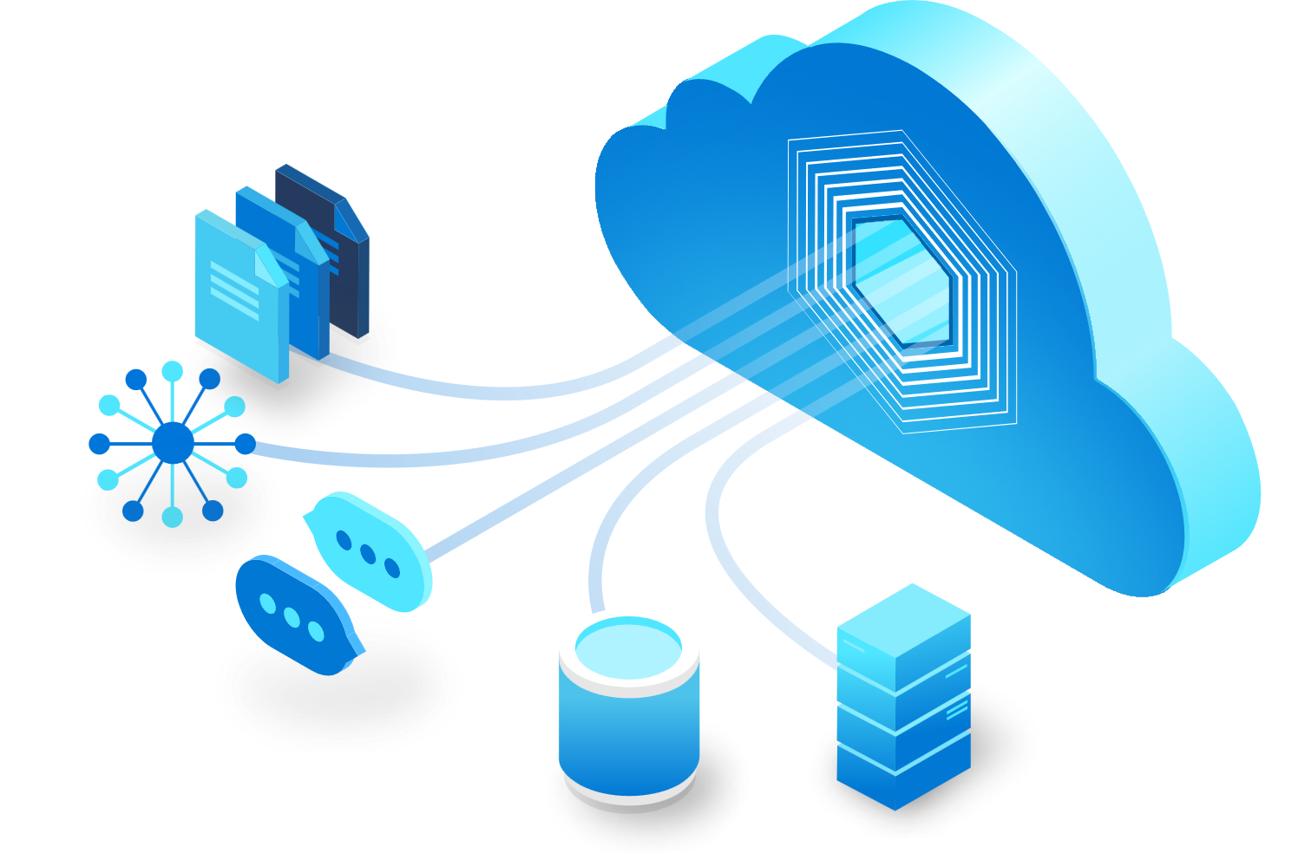
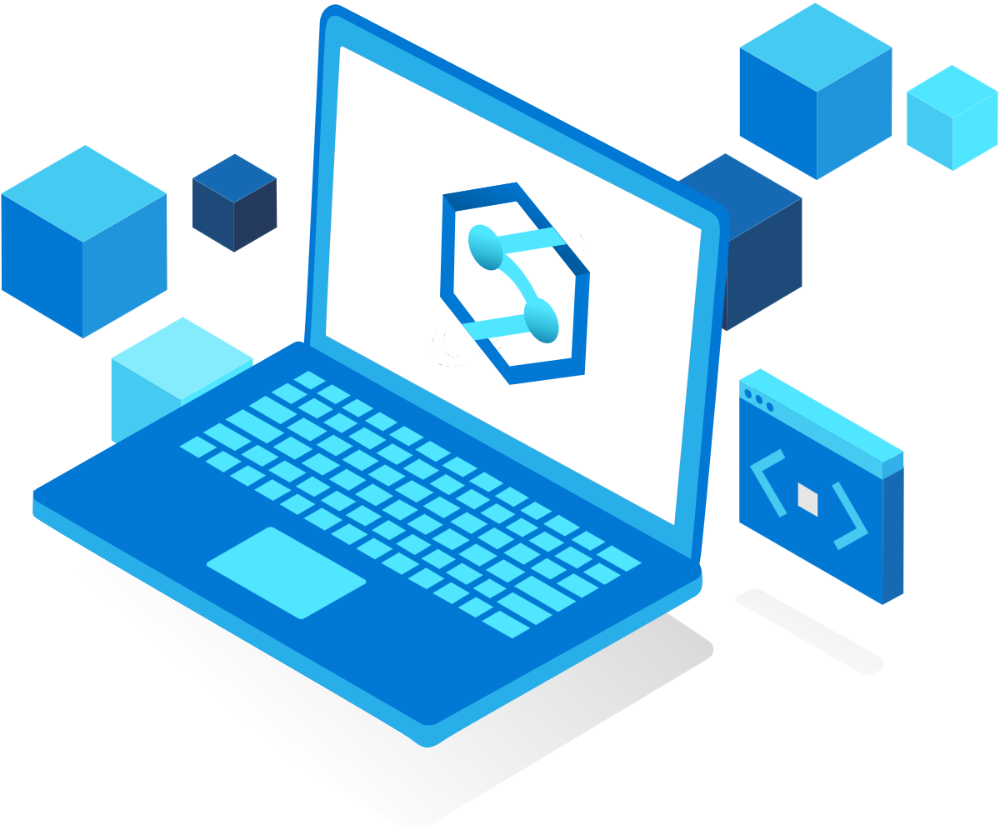
What is Synapse
Apache Spark
for Synapse
Synapse SQL
Synapse Pipelines
Synapse Studio
Query and analyze data with T-SQL using both provisioned and serverless models
Quickly create notebooks with your choice of Python, Scala, SparkSQL, and .NET for Spark
Build end-to-end workflows for your data movement and data processing scenarios
Execute all data tasks with a simple UI and unified workspace environment
Notes:
Give a quick overview of all components of Synapse Analytics, explaining that dedicated SQL pools is not the only benefit of the Synapse platform.
Dedicated SQL pool = enterprise Datawarehouse, mission-critical Datawarehouse. This is the focus of the workshop.
Serverless SQL Pool = run standard T-SQL queries over files in Azure storage.
Apache Spark is a parallel processing framework that supports in-memory processing to boost the performance of big data analytic applications. Spark pools in Azure Synapse Analytics enable the following key scenarios:
Data Engineering/Data Preparation
Apache Spark includes language features to support preparation and processing of large volumes of data so that it can be made more valuable and then consumed by other services within Azure Synapse Analytics. This approach is enabled through multiple languages, including C#, Scala, PySpark, and Spark SQL, and supplied libraries for processing and connectivity.
Machine Learning
Apache Spark comes with MLlib, a machine learning library built on top of Spark that you can use from a Spark pool in Azure Synapse Analytics. Spark pools in Azure Synapse Analytics also include Anaconda, a Python distribution with various packages for data science including machine learning. When combined with built-in support for notebooks, you have an environment for creating machine learning applications.
Reference: https://docs.microsoft.com/en-us/azure/synapse-analytics/spark/apache-spark-overview
4. A Data Factory or Synapse Workspace can have one or more pipelines. A pipeline is a logical grouping of activities that together perform a task. For example, a pipeline could contain a set of activities that ingest and clean log data, and then kick off a mapping data flow to analyze the log data. The pipeline allows you to manage the activities as a set instead of each one individually. You deploy and schedule the pipeline instead of the activities independently.
https://docs.microsoft.com/en-us/azure/data-factory/concepts-pipelines-activities?tabs=data-factory#overview
Pipelines are scheduled by triggers. There are different types of triggers (Scheduler trigger, which allows pipelines to be triggered on a wall-clock schedule, as well as the manual trigger, which triggers pipelines on-demand). For more information about triggers, see pipeline execution and triggers article.
https://docs.microsoft.com/en-us/azure/data-factory/concepts-pipelines-activities?tabs=data-factory#scheduling-pipelines
Linked services are much like connection strings, which define the connection information needed for the service to connect to external resources.
https://docs.microsoft.com/en-us/azure/data-factory/concepts-linked-services?tabs=data-factory
The Integration Runtime (IR) is the compute infrastructure used by Azure Data Factory and Azure Synapse pipelines to provide the data integration capabilities across different network environments.
https://docs.microsoft.com/en-us/azure/data-factory/concepts-integration-runtime
Please review the below link for more details related to pipeline:
https://docs.microsoft.com/en-us/azure/data-factory/concepts-pipelines-activities?tabs=data-factory
5. The Azure Synapse Studio is a one-stop-shop for all your data engineering and analytics development, from data exploration to data integration to large scale data analysis.
On the Home hub of the Studio, you can easily begin loading data, extracting insights, building interactive reports with Power BI and accessing learning resources in the Knowledge Center to quickly get started with Azure Open Datasets, one-click tutorials, and virtual tours.
https://techcommunity.microsoft.com/t5/azure-synapse-analytics-blog/quickly-get-started-with-azure-synapse-studio/ba-p/1961116
https://docs.microsoft.com/en-us/azure/synapse-analytics/sql-data-warehouse/sql-data-warehouse-overview-what-is

Slide 6
SQL: Serverless vs Dedicated
Serverless pay-per-query ideal for ad-hoc data lake exploration and transformation
Dedicated clusters optimized for mission-critical data warehouse workloads
Serverless
(On-Demand)
Dedicated
(Provisioned)
Notes:
→ We are aware of the huge range of functionality available with Synapse, so it’s nice to have a choice about how you allocate and consume resources as well.
→ allows you to chose the best pricing option for each workload, by offering both serverless + dedicated option, giving you more flexibility and better budget control.
For predictable performance and cost, you can create dedicated SQL pools to reserve processing power for data stored in SQL tables.
for unplanned or bursty workloads, you can use the always-available, serverless SQL endpoint.
More info: (Synapse SQL architecture - Azure Synapse Analytics | Microsoft Docs)

Slide 7
Key Concepts
Control Node
Compute Nodes
Distributions
Notes:
Let’s talk about each of these concepts individually

Slide 8
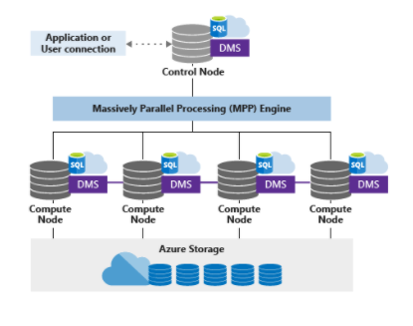
Control Node
The brain of the MPP architecture
It is the front end to that interacts with applications and connections
The distributed query engine runs on the control node
Responsible for optimizing and coordinating queries
Notes:
Connection and tool endpoint.
Coordinates compute activity.
The only one the user can connect to.

Slide 9
Compute Nodes
The brawn of the MPP architecture
Provides computational power
Number of compute nodes can range from 1 to 60
Notes:
Compute Node = VM hosting 2 key components of SQL DW.
There are 2 key components: SQL DB and DMS.
DMS = Data Movement Service
(Cover more later on “why move data”)
SQL DB → crunching the data
DMS → moving the data

Slide 10
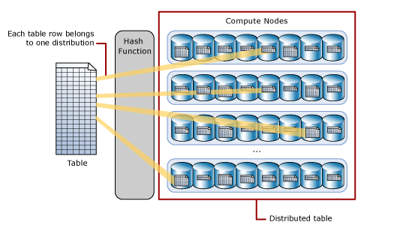
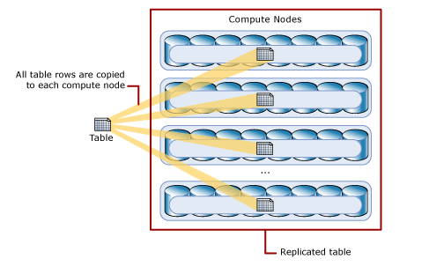
Distributions
The work is divided into 60 distributions
Various ways to distribute the data:
Hash-distributed tables
Round-robin distributed tables
Replicated tables
Notes:
Data is distributed into 60 distributions on storage
Each compute node is associated with a set of distributions
1 Node would have all 60 distributions
60 nodes would have 1 distribution each
Each distribution is one database attached to a SQL Server in one of the nodes
More details on table data distribution on upcoming lessons.

Slide 11
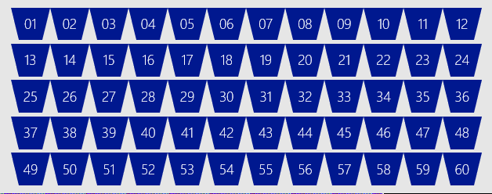
Synapse SQL MPP Architecture (DW2000)
Control
Engine
DMS
SQL DB
Compute
Compute
Compute
Compute
DMS
DMS
DMS
DMS
SQL DB
SQL DB
SQL DB
SQL DB
Dist_DB_1
Dist_DB_2
Dist_DB_15
Dist_DB_16
Dist_DB_17
Dist_DB_30
Dist_DB_31
Dist_DB_32
Dist_DB_45
Dist_DB_46
Dist_DB_47
Dist_DB_60
…
…
…
…
Blob Storage
Notes:
Compute Node VM hosting two key components of SQL DW.
These two key SQL DB and DMS.
DMS, stands for Data Movement Service
cover more later on why move data
SQL DB crunching the data and DMS moving
Third component to SQL DW, the Engine.
primary function is to optimize and manage incoming work.
Engine parses and creates query plans.
Compute node has several SQL databases.
MPP
Data is distributed into 60 distributions on storage
Each compute node is associated with a set of distributions
1 Node would have all 60 distributions
60 nodes would have 1 distribution each
This example is DW2500, each compute node is hosting 12 distributions.
Let’s say we want to take this DW2500 and scale it up to a DW5000
What happens behind the scenes?
(1) take all of the SQL Databases down,
(2) add 5 more compute nodes
(3) start up the SQL DB databases again.
some of the databases are on different compute nodes
6 distributions per node rather than 12
Each Node has half the work now
More info: https://docs.microsoft.com/en-us/azure/synapse-analytics/sql-data-warehouse/massively-parallel-processing-mpp-architecture
DMS is the legacy service used to move data within the SQL Pool, it is being replaced with a a direct SQL – SQL movement process, that eliminates the Buffering used in DMS. This is significantly more streamlined compared to DMS.
DMS is still used for certain moves, and for PolyBase for external connections.

Slide 12
Scaling Compute
cDWU | # of Compute Nodes | # Distributions per node | Memory per data warehouse (GB) | Tempdb (TB) | Adaptive Cache (TB)
DW100c | 1 | 60 | 60 | .4 | .3
DW200c | 1 | 60 | 120 | .8 | .6
DW300c | 1 | 60 | 180 | 1.2 | .9
DW400c | 1 | 60 | 240 | 1.6 | 1.2
DW500c | 1 | 60 | 300 | 2 | 1.5
DW1000c | 2 | 30 | 600 | 4 | 3
DW1500c | 3 | 20 | 900 | 6 | 4.5
DW2000c | 4 | 15 | 1200 | 8 | 6
DW2500c | 5 | 12 | 1500 | 10 | 7.5
DW3000c | 6 | 10 | 1800 | 12 | 9
DW5000c | 10 | 6 | 3000 | 19 | 15
DW6000c | 12 | 5 | 3600 | 23 | 18
DW7500c | 15 | 4 | 4500 | 29 | 22.5
DW10000c | 20 | 3 | 6000 | 39 | 30
DW15000c | 30 | 2 | 9000 | 58 | 45
DW30000c | 60 | 1 | 18000 | 117 | 90
Notes:
Finding the right size of data warehouse units
To see the performance benefits of scaling out, especially for larger data warehouse units, you want to use at least a 1-TB data set. To find the best number of data warehouse units for your SQL pool, try scaling up and down. Run a few queries with different numbers of data warehouse units after loading your data. Since scaling is quick, you can try various performance levels in an hour or less.
Recommendations for finding the best number of data warehouse units:
For a SQL pool in development, begin by selecting a smaller number of data warehouse units. A good starting point is DW400c or DW200c.
Monitor your application performance, observing the number of data warehouse units selected compared to the performance you observe.
Assume a linear scale and determine how much you need to increase or decrease the data warehouse units.
Continue making adjustments until you reach an optimum performance level for your business requirements.
When to scale out
Scaling out data warehouse units impacts these aspects of performance:
Linearly improves performance of the system for scans, aggregations, and CTAS statements.
Increases the number of readers and writers for loading data.
Maximum number of concurrent queries and concurrency slots.
Recommendations for when to scale out data warehouse units:
Before you perform a heavy data loading or transformation operation, scale out to make the data available more quickly.
During peak business hours, scale out to accommodate larger numbers of concurrent queries.

Slide 13
Cores
Memory
Control
SSD TempDB
Cores
Memory
Cores
Memory
Cores
Memory
NVMe SSD
NVMe SSD
NVMe SSD
Compute
Cache
TempDB
Cache
TempDB
Cache
TempDB
Data
Remote storage
Snapshot backups
Log
Notes:
In this slide you need to be focus on the Control node and Compute node components.
The animation explains how the storage is queried and data goes to the Cache to minimize the request latency.
The first time you query data, the data goes from the Storage to the cache. The other request occurrences, the data will remain in the Cache.
The cache is also used for the replicated tables. In the background the Replicated table is stored as a Round-robin Distributed table. When you scale or resume, the replicated table are not stored in the cache. The data will reside in the cache the first time it will be requested.
Non-Volatile Memory / Flash Memory hosting Cache and tempdb
NVM Express reduces I/O overhead and brings various performance improvements in comparison to previous logical-device interfaces, including multiple, long command queues, and reduced latency.
Continue explaining the different layers by being focus on the NVMe SSD containing the cache and the Tempdb,

Slide 14
Table Distribution Options
Data repeated on every node
Simplifies many query plans and reduces data movement
Best with joining hash table
Replicated
Round Robin (Default)
Hash Distributed
Data divided across nodes based on hashing algorithm
Same value will always hash to same distribution
Multi-column now available.
Data distributed evenly across nodes
Easy place to start, don’t need to know anything about the data
Simplicity at a cost
Notes:
Explain very lightly the different types of tables in Synapse SQL pools
Don’t go deeper as all the Table geometry will be explain in Module 3
Just add some scenarios based on your Data warehousing experience.
Note that Table Design is covered in detail in Mod 3 "Designing for Performance"

Slide 15
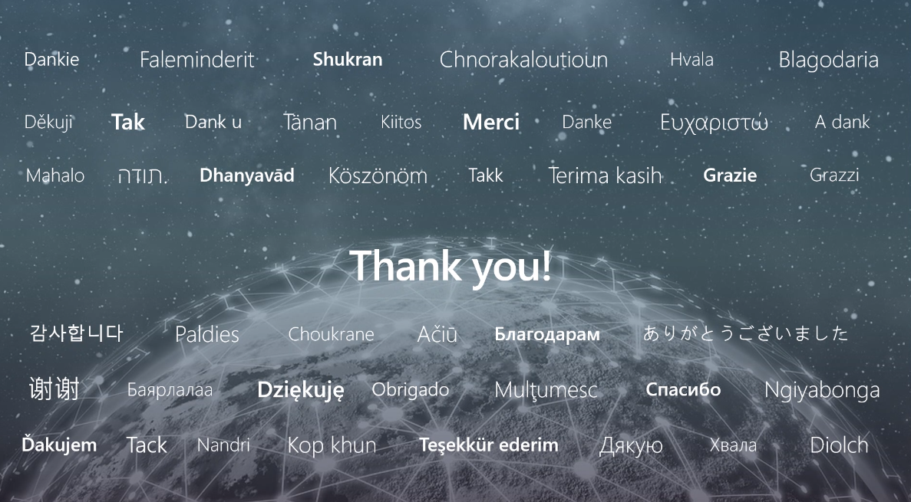

Slide 16
Microsoft

